Slide 1
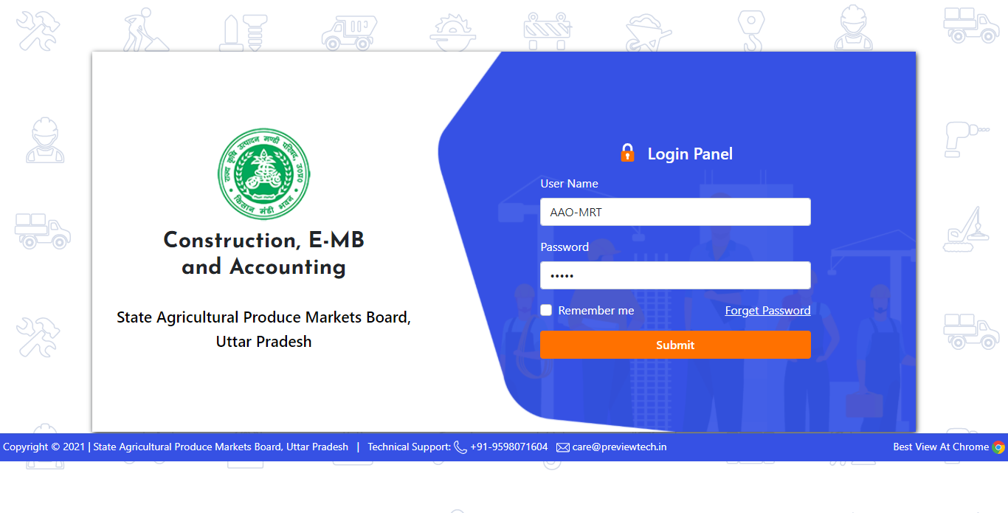
LOGIN ON
“Construction, E-MB and Accounting Portal”
Start Working AAO

Slide 2
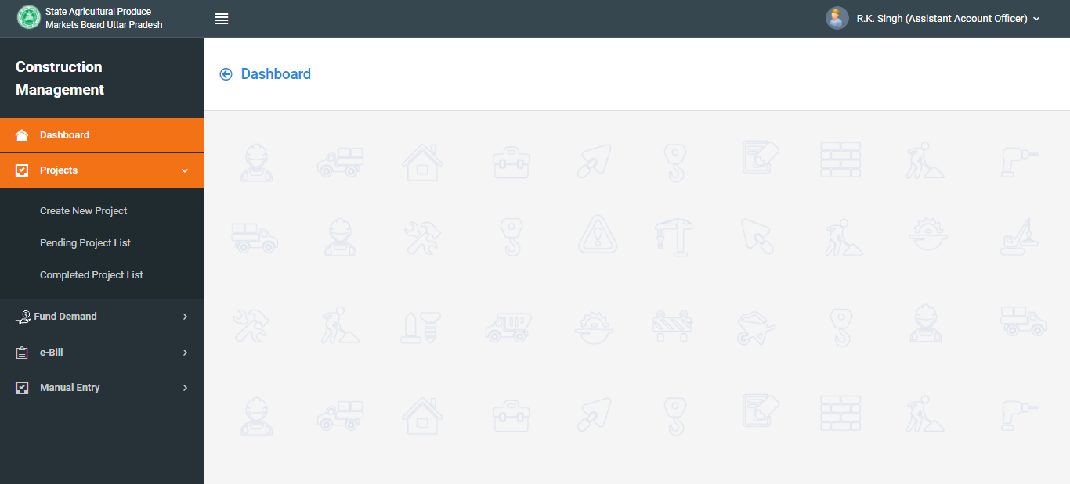
Start Working AAO
Click On Tab: Projects > Create New Project

Slide 3
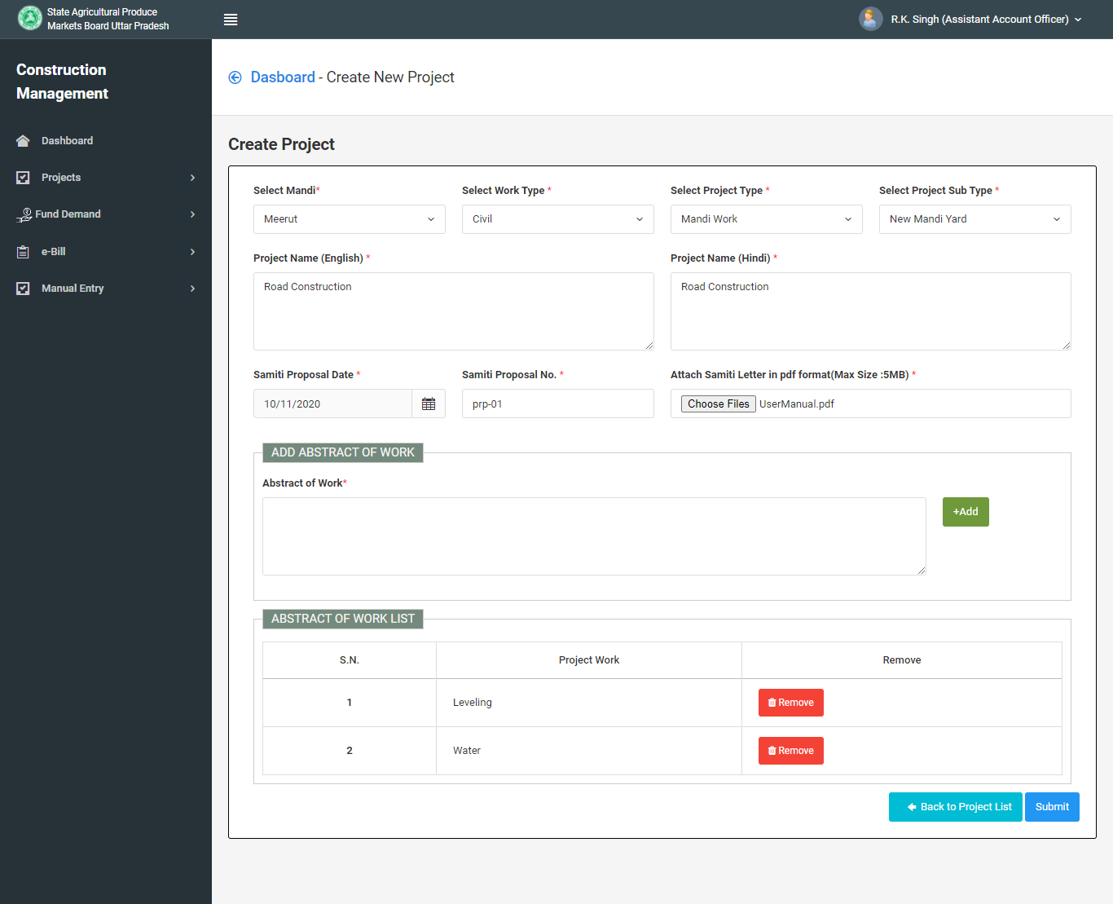
For Create Project : Fill all field and Submit form

Slide 4
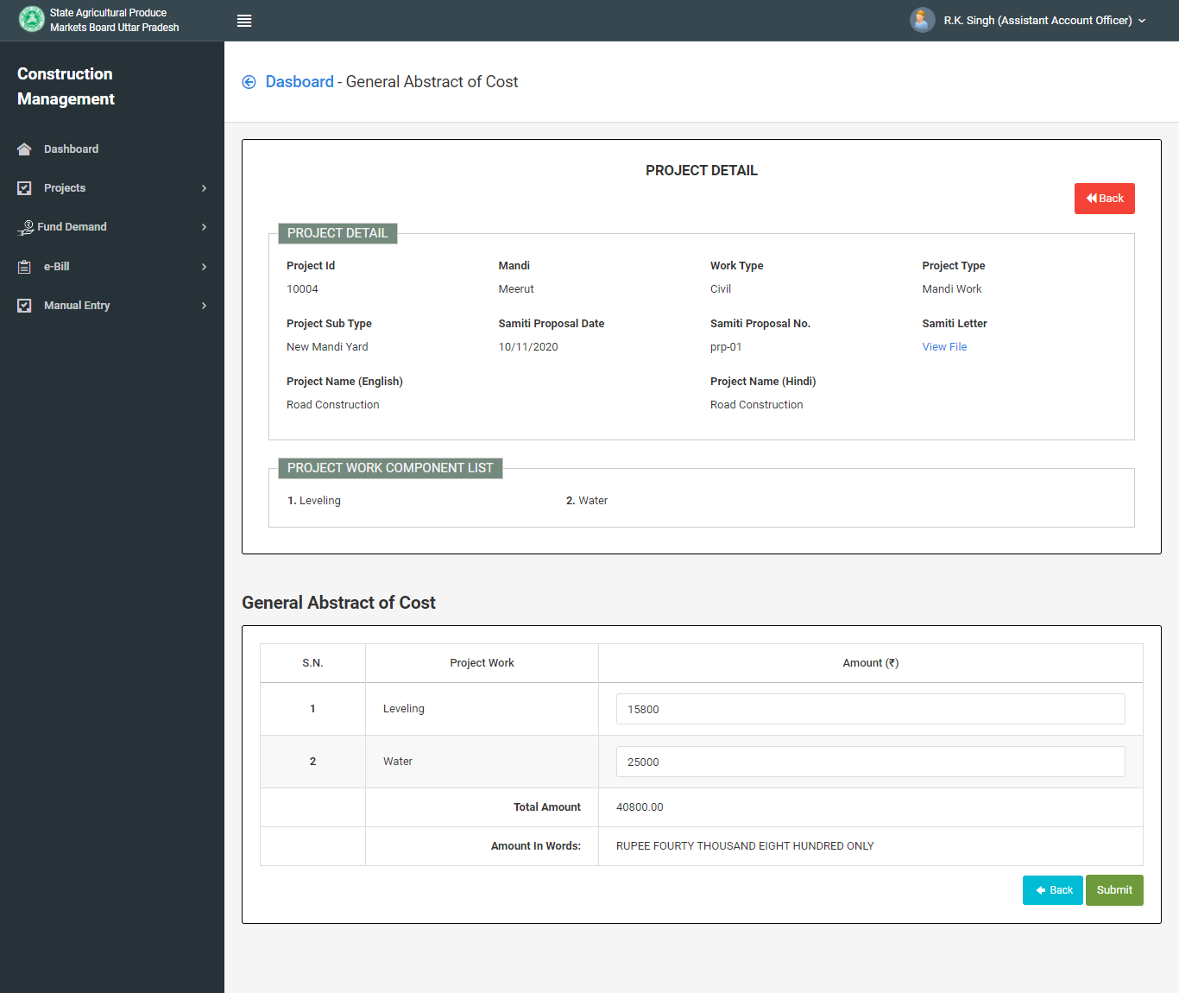
Fill “General Abstract of Cost” & Submit

Slide 5
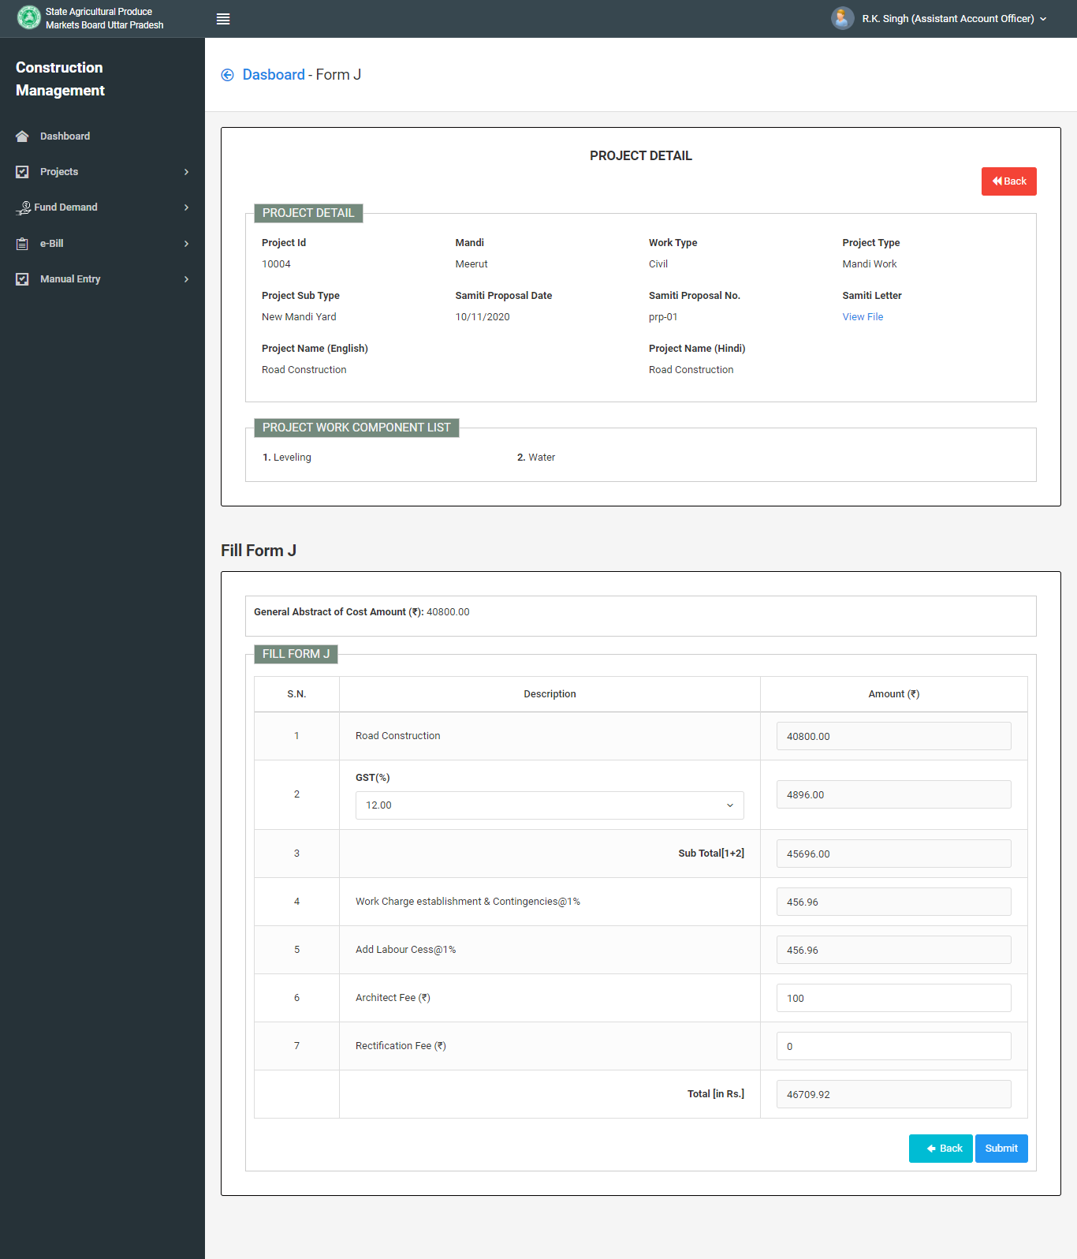
Fill fields for Form J & Submit

Slide 6
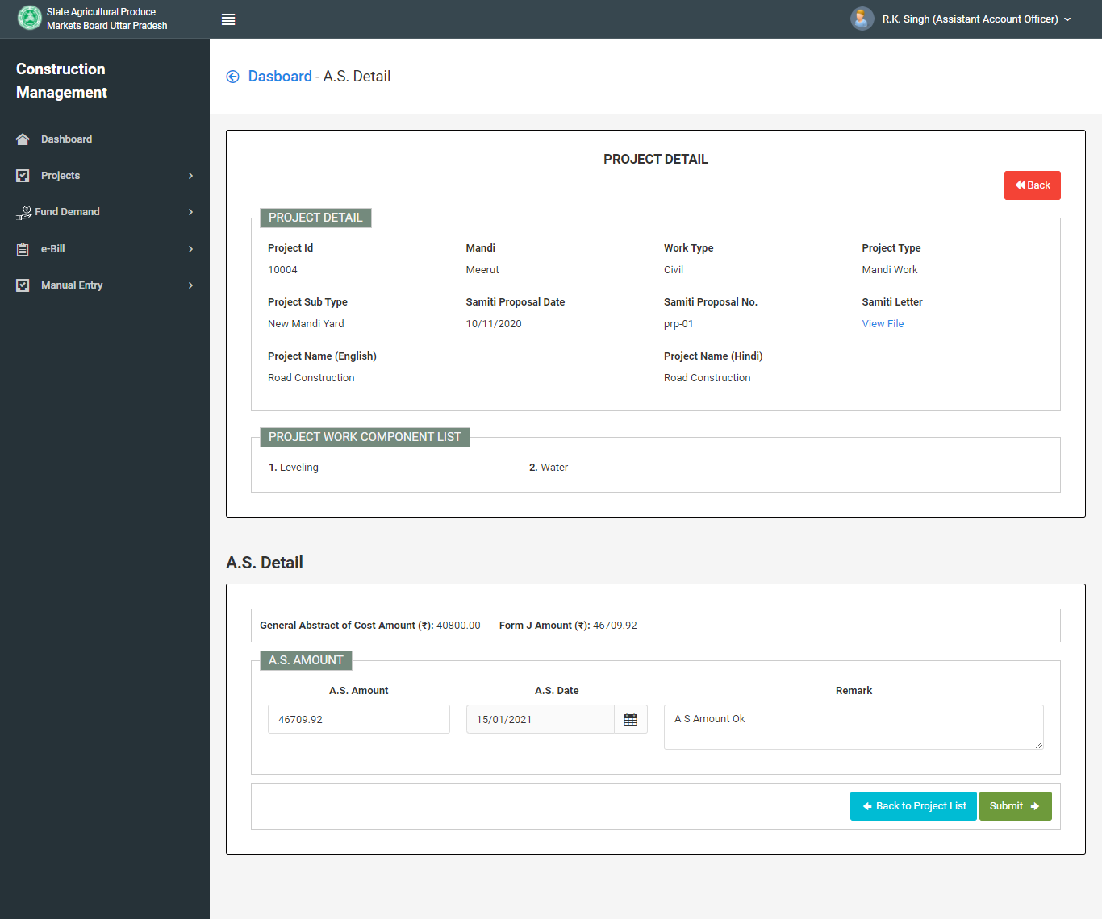
Fill fields for A. S. Details & Submit

Slide 7
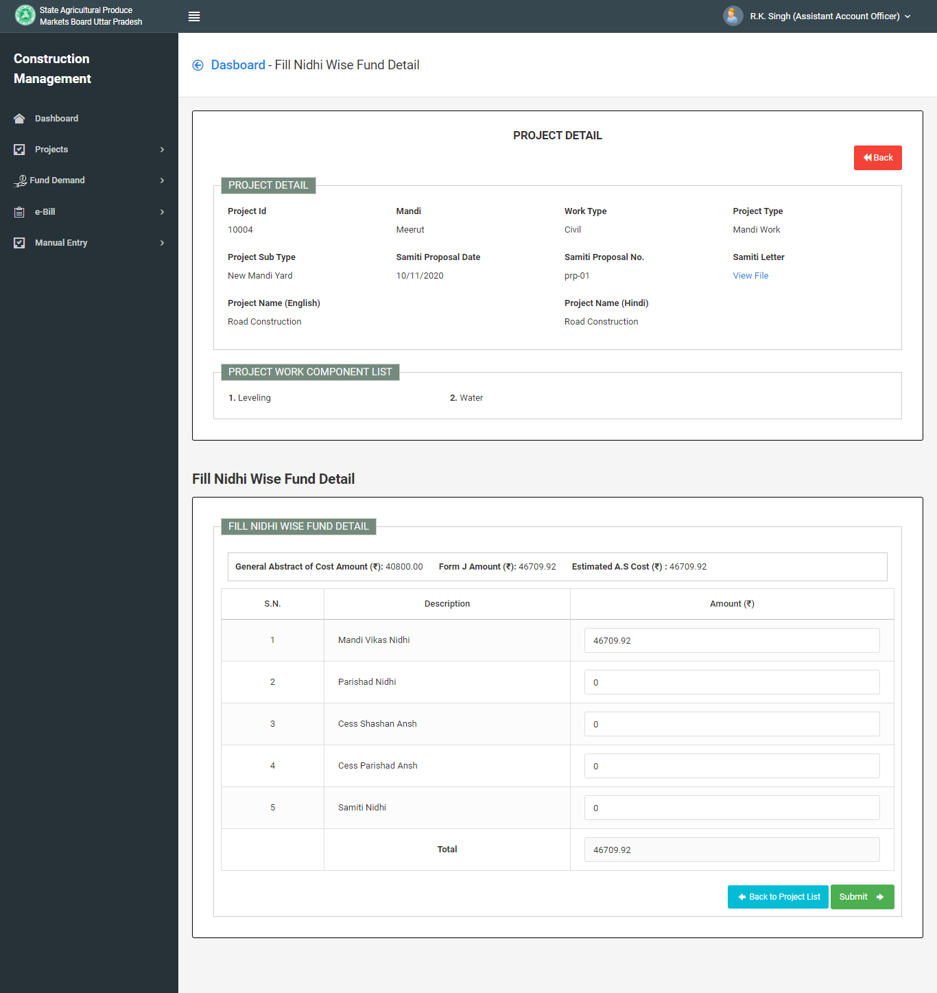
Go to Next Step for “Fill Nidhi Wise Fund Details”

Slide 8
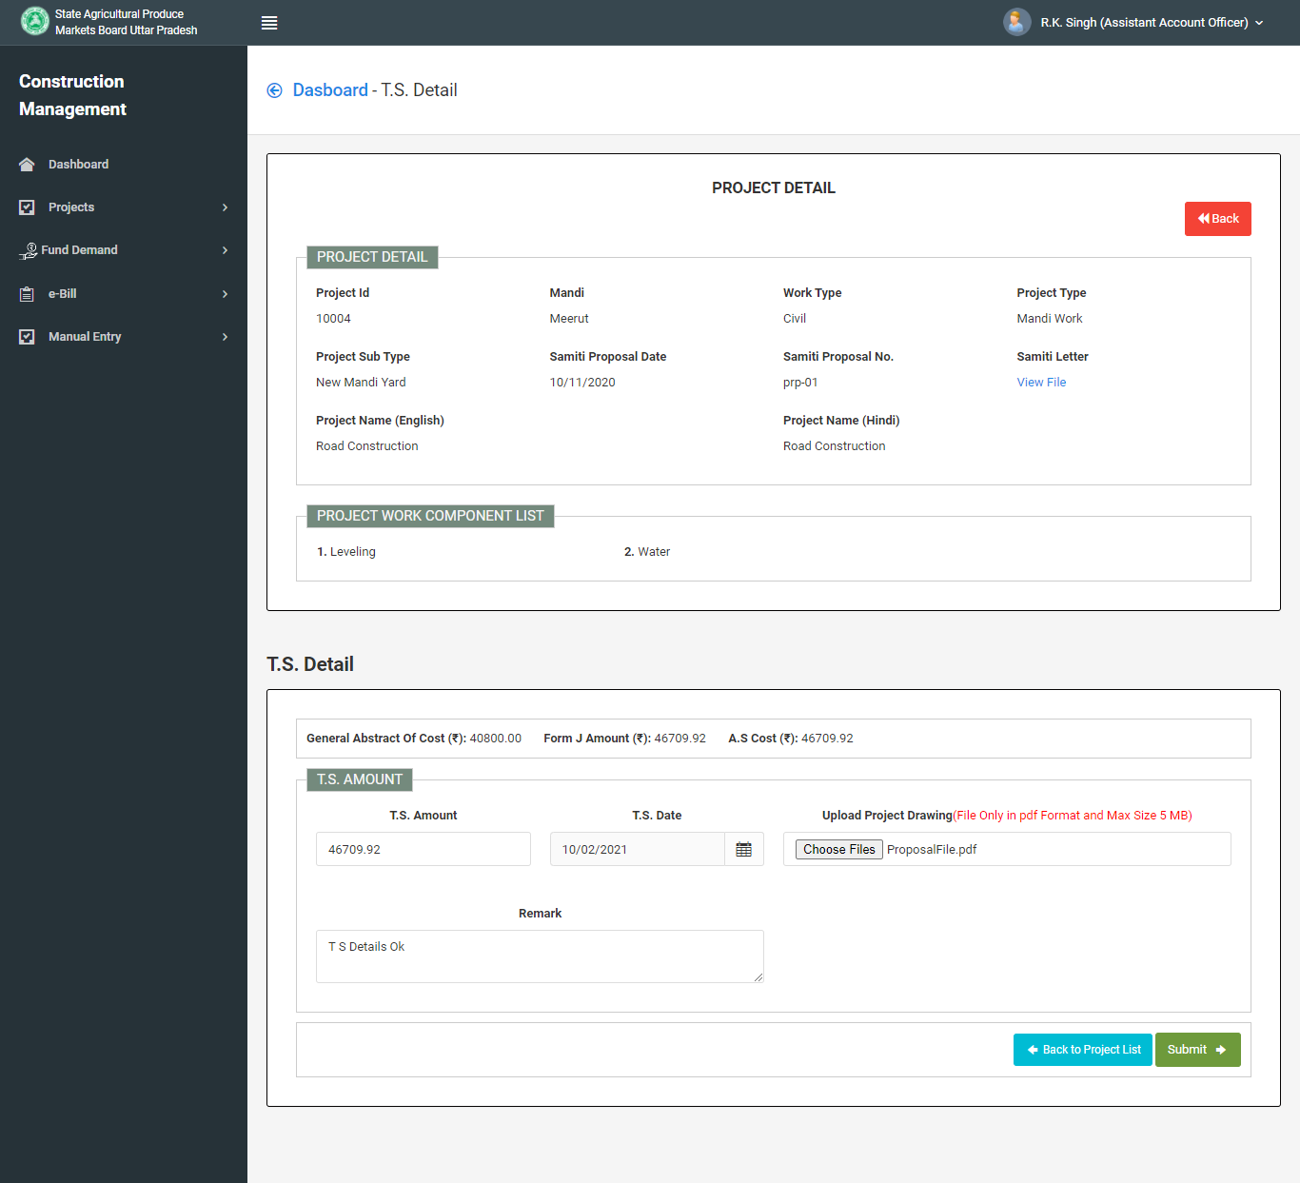
Fill fields for T.S. Details & Submit

Slide 9
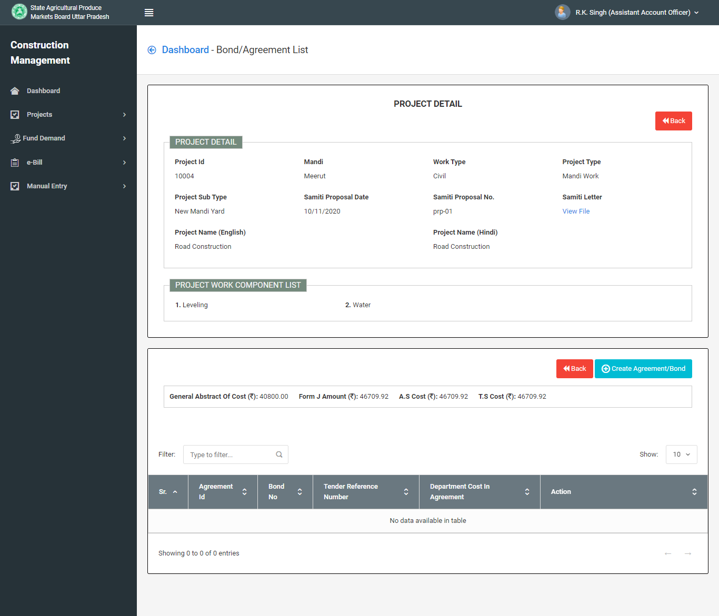
Click Create “Agreement/Bond Button“
for Fill BOND/BOQ

Slide 10
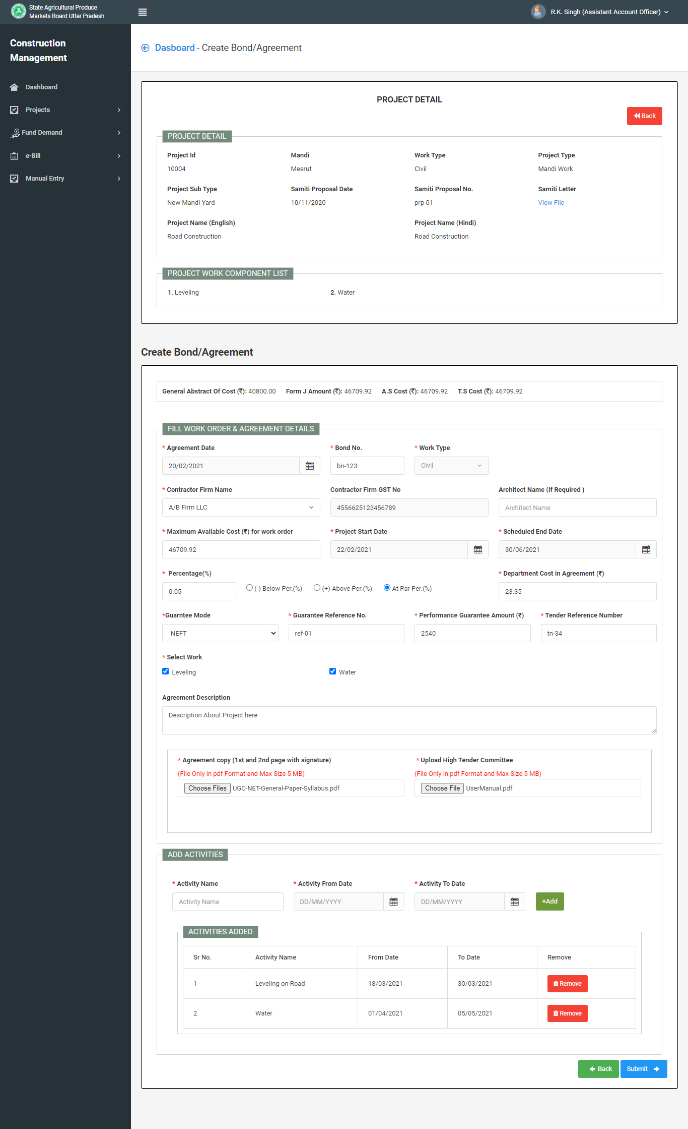
Fill fields for Fill BOND/Agreement & Submit

Slide 11
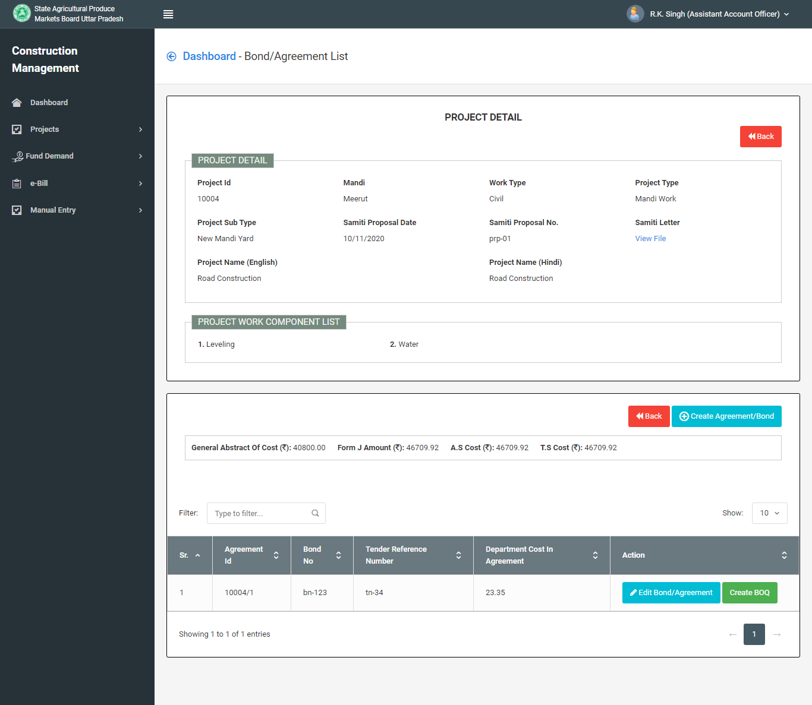
For Fill BOQ Click CREATE BOQ button

Slide 12
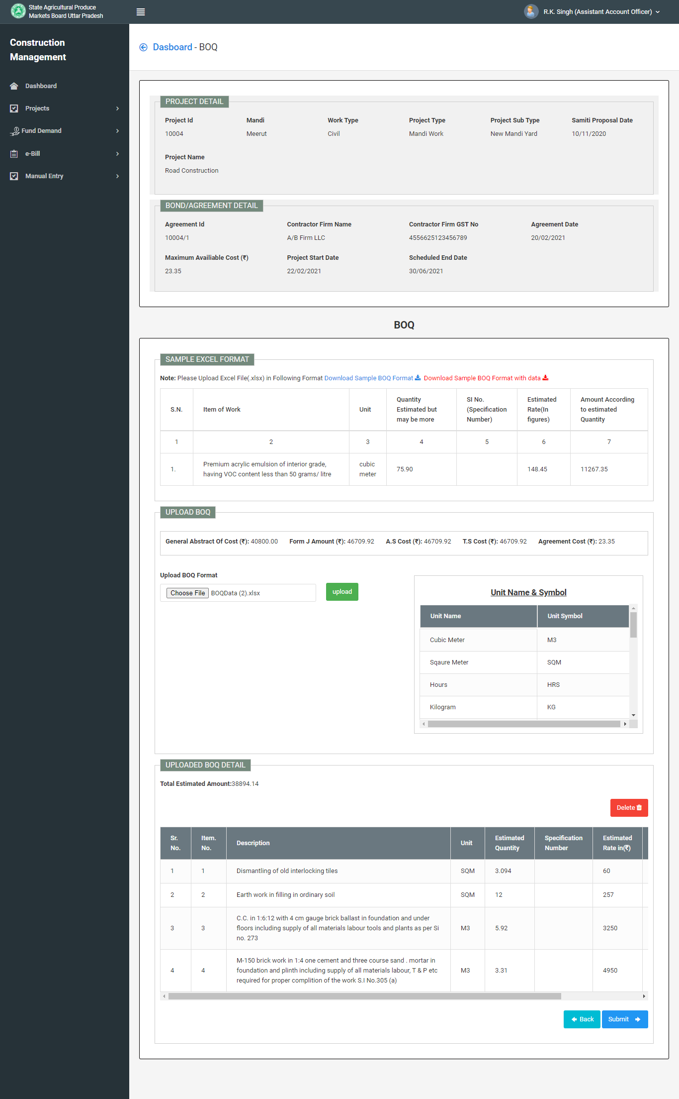
Fill BOQ & Submit
Note : Download Sample BOQ format. You can upload Multiple BOQ items of work filled in Excel .

Slide 13
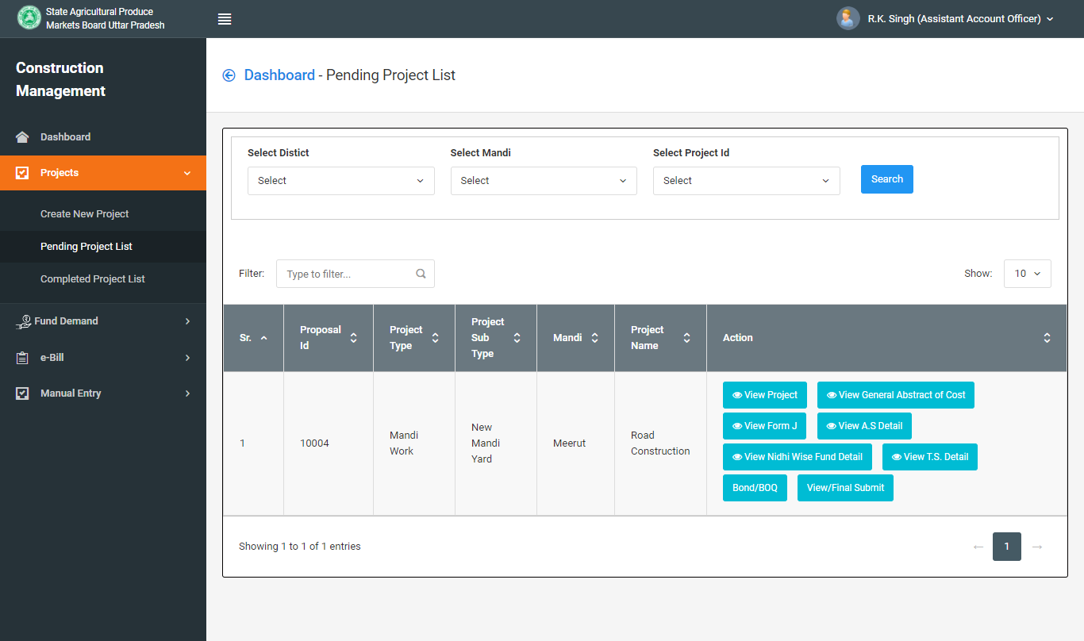
Click View/Final Submit & Check all details you were filled.

Slide 14
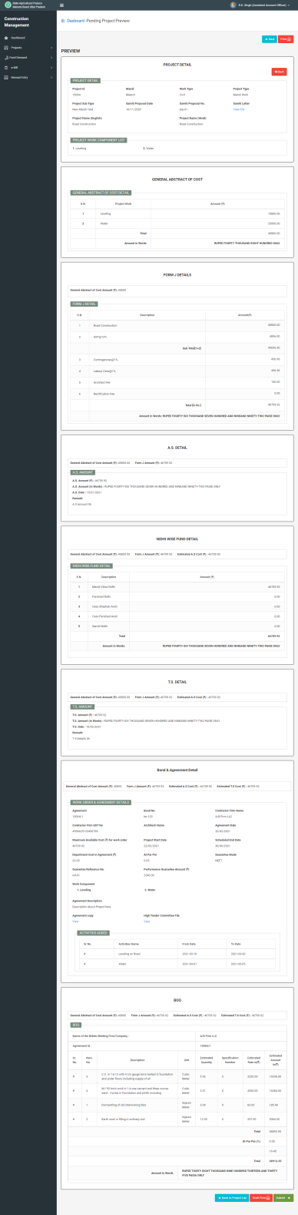
Check all details you were filled and Click to Final Submit

Slide 15
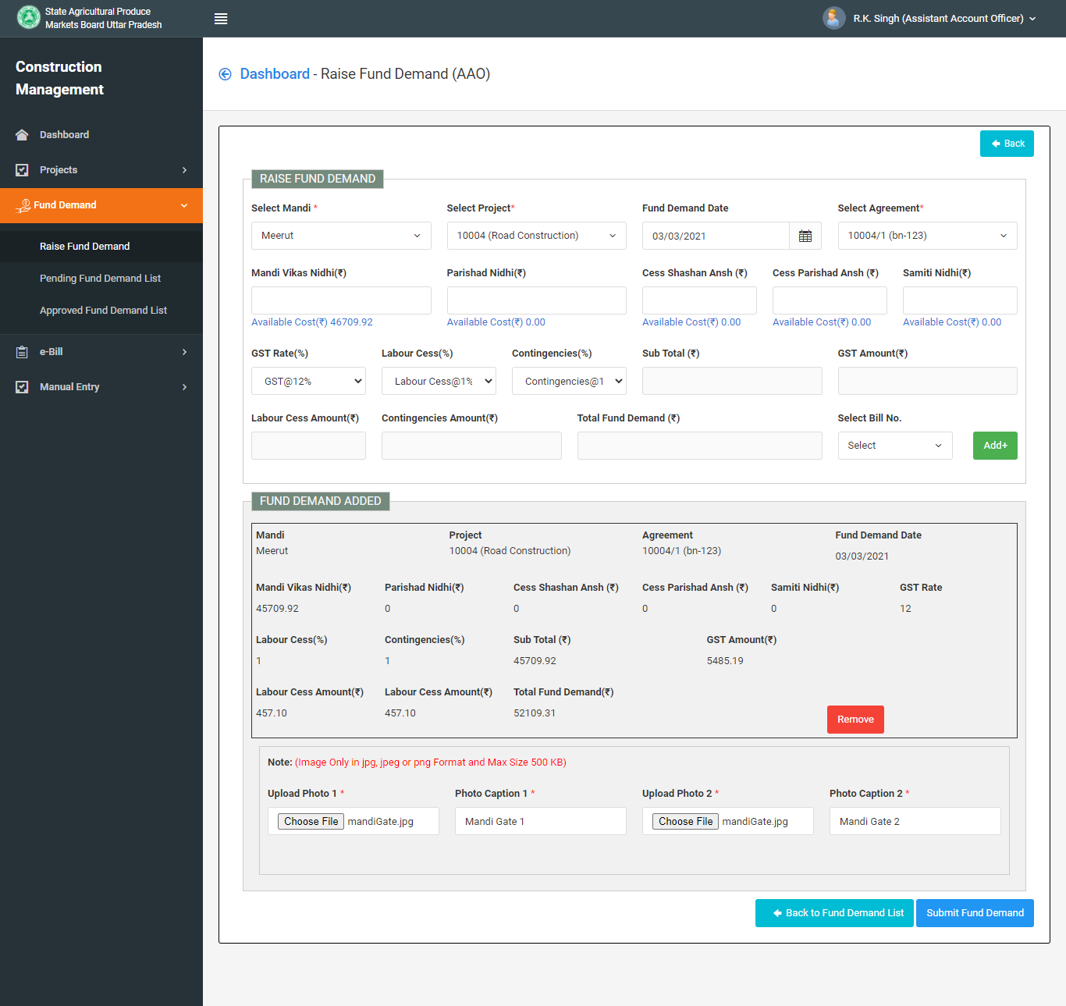
For Raise Fund Demand :
Fill Details, Upload Photos and Submit Fund Demand Button

Slide 16
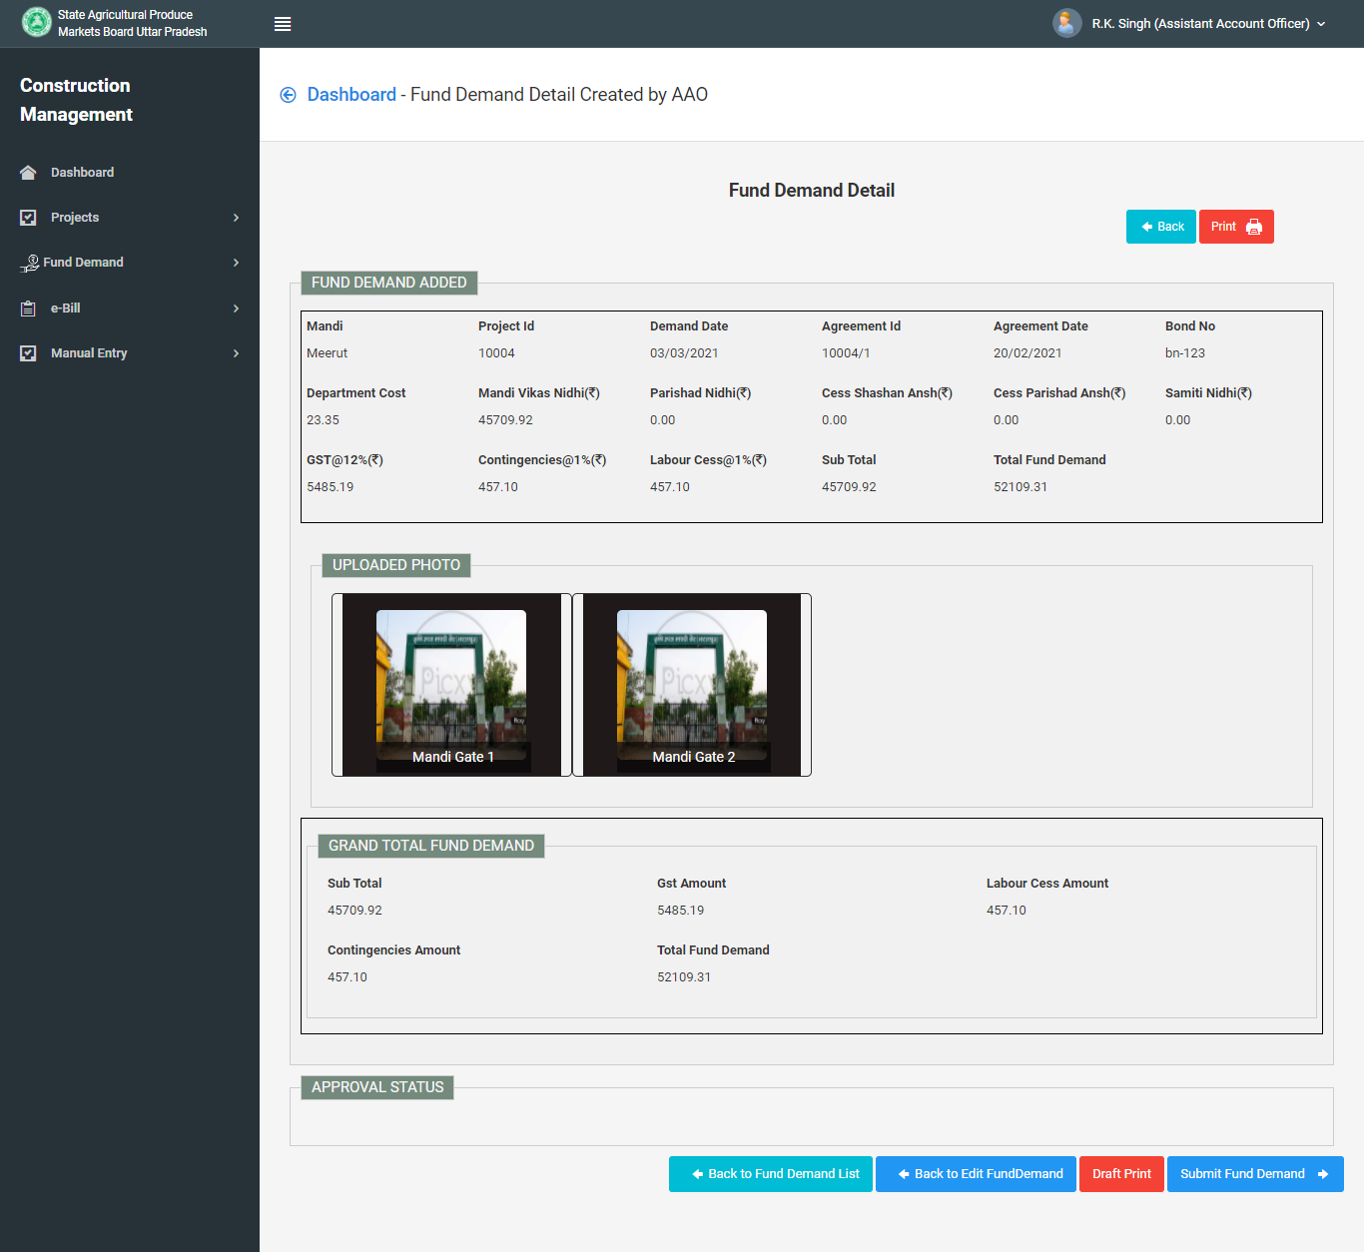
Preview Fund Demand Details , Click Submit Fund Demand

Slide 17
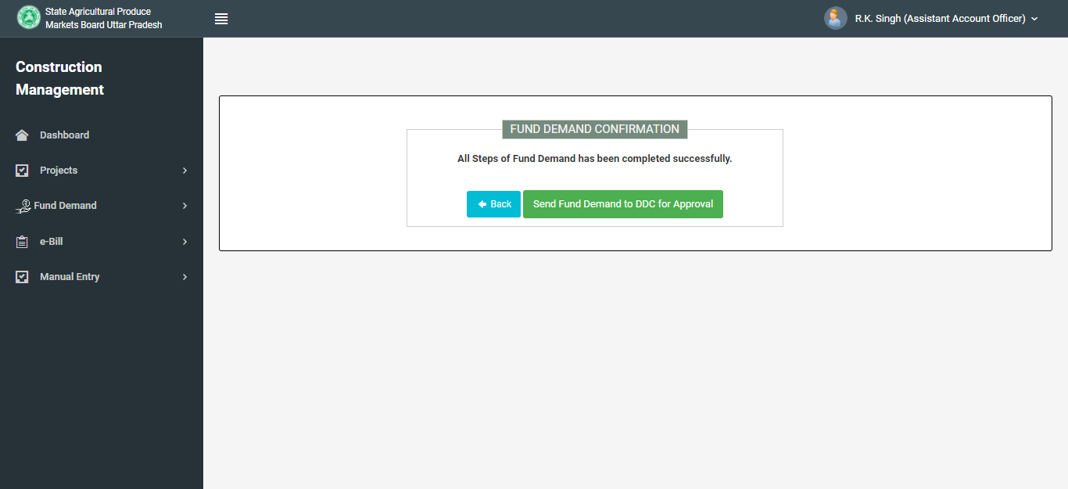
Fund Demand has been Completed Successfully
Note: After Submit Fund Demand Click on Send Fund Demand to DDC for Approval

