Slide 1
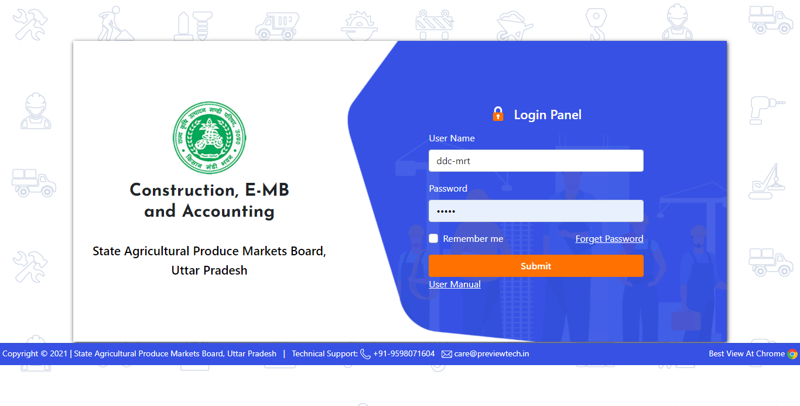
Start Working DDC
Enter DDC Username & Password

Slide 2
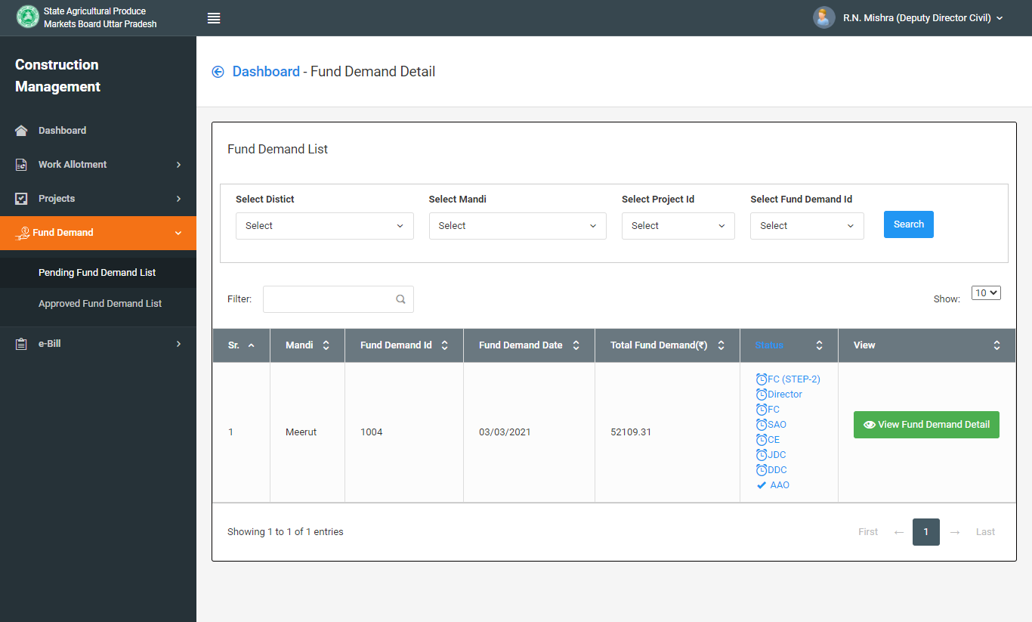
For Approve Fund Demand click to View Fund Demand Details

Slide 3
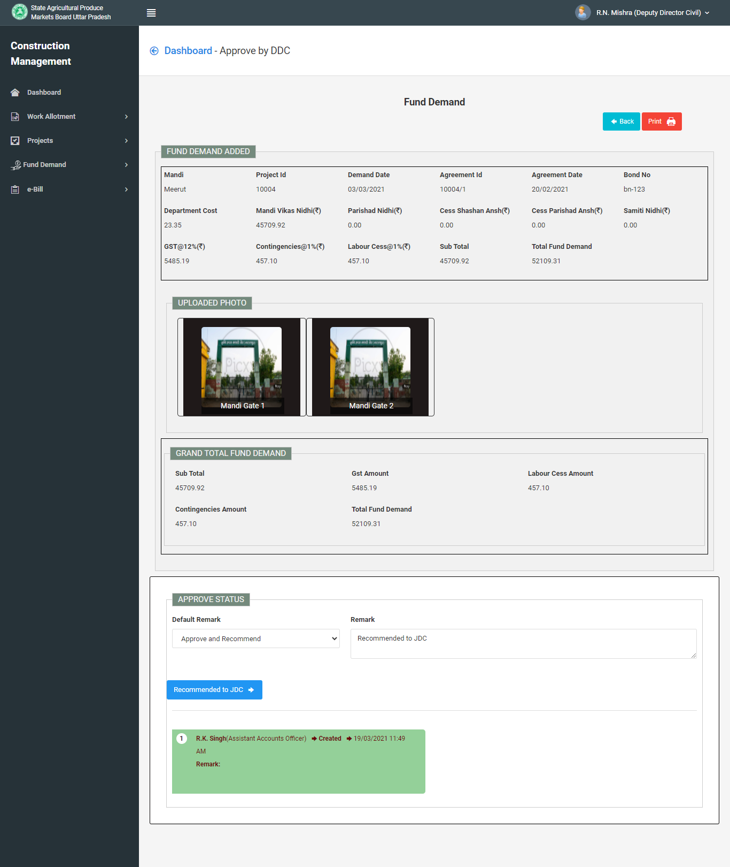
For Approve Fund Demand and Recommended to JDC

Slide 4
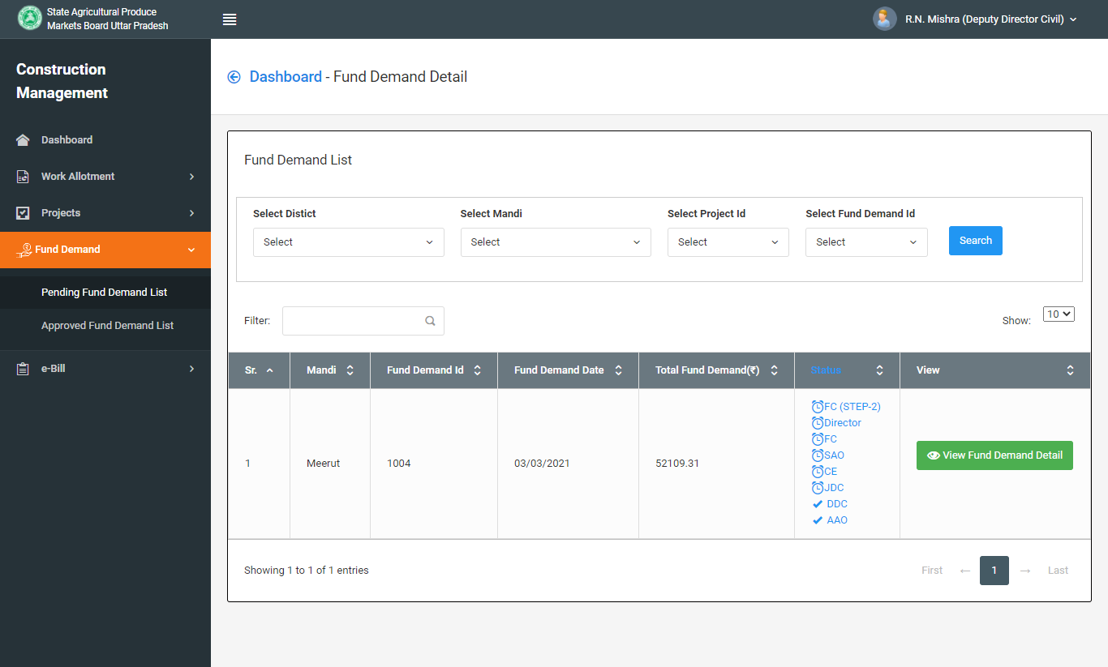
Fund Demand Approved and Recommended to JDC from DDC
Note : You can see Status

Slide 5
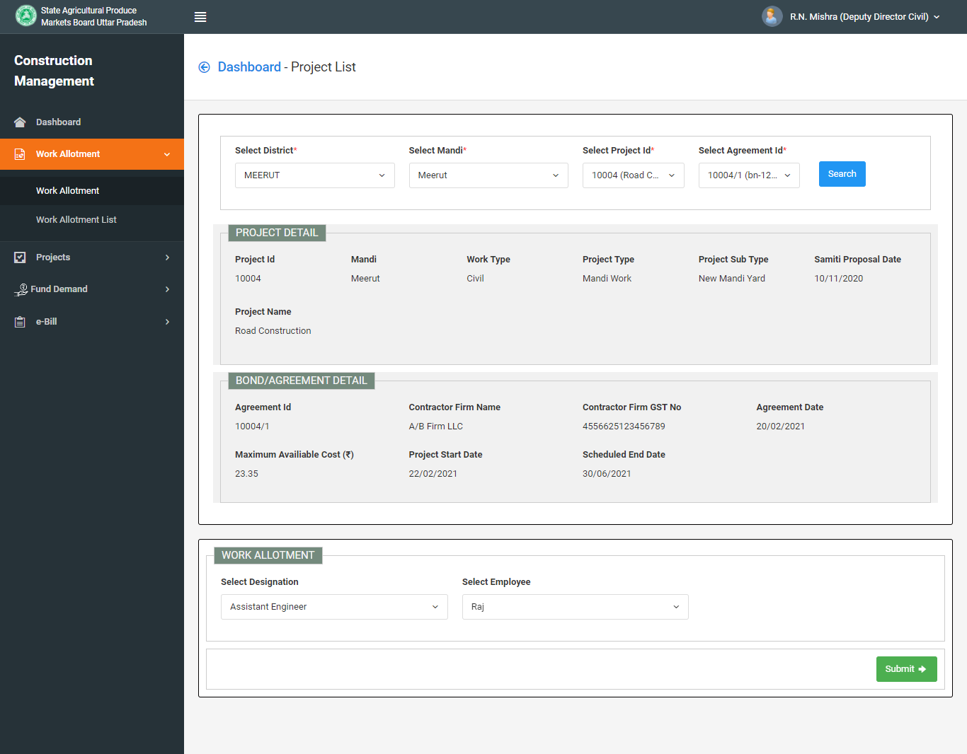
Click On : Work Allotment > Work Allotment
Note : You can allot work to A.E. and J.E. both.

